Slide 1




CSS Transitions, Animations & Grids
Beautiful Effects with CSS
CSS Transitions, Animations & Grids
SoftUni Team
Technical Trainers
Software University
http://softuni.bg

Slide 2


Table of Contents
CSS Transitions
Delay, duration, property, timing-function
CSS Animations
Delay, direction, duration
Iteration - count, name, play-state, timing-function
CSS Grids
Basics & Browser Support
Grid Properties
Important Terminology

Slide 3
Have a Question?
sli.do #front-end

Slide 4

CSS Transitions
CSS Transitions and Transforms

Slide 5

What is CSS Transition?
CSS transitions animate elements when changing CSS properties
:hover, :focus, :active, :target
Transition syntax:
Transition example:
Required
Required
Optional
Optional
div {
transition: [property][duration][timing-function][delay]
}
div {
transition: width 2s;
}
div:hover {
width: 300px;
}

Slide 6
Problem: Button Transition
.btn {
width: 100px;
height: 50px;
border: none;
background: #F3BE60;
color: white;
border-radius: 4px;
transition: all 0.5s linear 0s;
}
.btn:hover {
width: 200px;
height: 100px;
background: #234465;
font-size: 25px;
cursor: pointer; }
<button class="btn">
BUTTON
</button>

Slide 7
Transition Timing Function
Timing function defines how the transitions speed changes over the time (e.g. start fast, end slow)
#div1 {
transition-timing-function:
linear / ease / ease-in / ease-out / ease-in-out
}
.btn {
…
transition: all 2s ease;
}

Slide 8




CSS Transform
Transform: skewX (deg), skewY(deg)
Transform: scale
Transform: rotate
Transform: translate
transform:skewY(20deg);
transform:scaleX(1.2);
transform:rotateX(-20deg);
transform:translateX(30%);

Slide 9
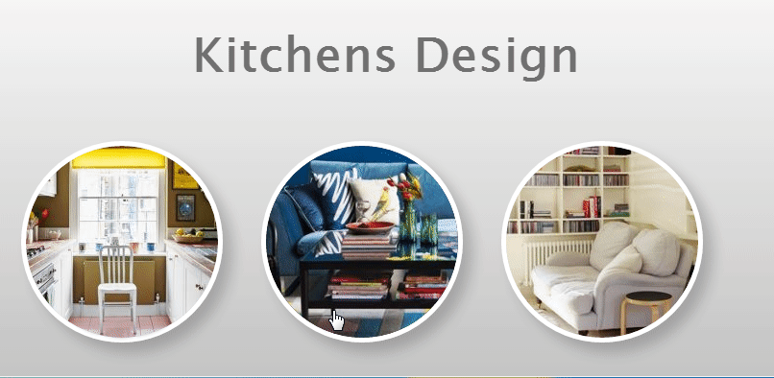
Problem: Kitchens Design
You are given an HTML file + CSS styles (unfinished)
Write the missing CSS transitions

Slide 10
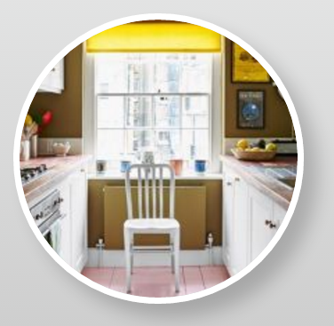

Solution: Kitchen Design CSS (Effect 1)
.effect-1 p {
transition: opacity 0.5s;
}
.effect-1 p:hover {
transition: opacity 0.5s;
opacity: 0.8;
cursor: pointer;
}

Slide 11

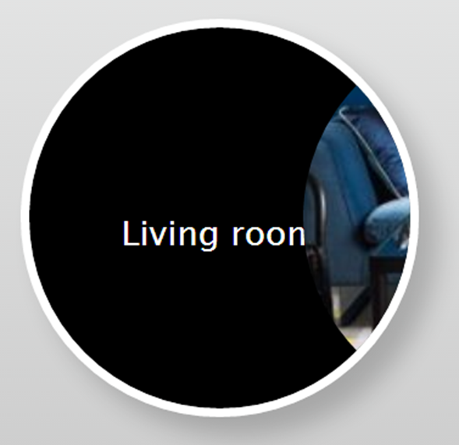
Solution: Kitchen Design CSS (Effect 2)
.effect-2 img {
transition: margin-left 1.2s;
}
.effect-2:hover img {
margin-left: 200px;
}
.effect-2 p:hover {
cursor: pointer;
}

Slide 12

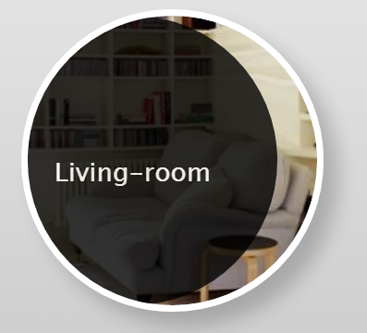
Solution: Kitchen Design CSS (Effect 3)
.effect-3 p {
transition: margin-left 0.7s 0.5s;
}
.effect-3:hover p {
margin-left: 0;
cursor: pointer;
}

Slide 13

Problem: Sport Trainers
You are given an HTML file + CSS
Write the missing CSS transitions

Slide 14



Solution: Sport Trainers CSS
.box {
transition: all 0.7s;
}
.box:hover {
padding-left: 100px;
}
.box:before {
transition: all 0.45s;
}
.box:hover:before {
right: -300px;
}

Slide 15
Solution: Sport Trainers CSS (2)
.menu {
transition: all 0.45s;
}
.menu:hover { left: 0; }
ul li a {
transition: all 0.3s;
}
ul li a:hover {
padding-left: 5px;
font-weight: bold;
}

Slide 16
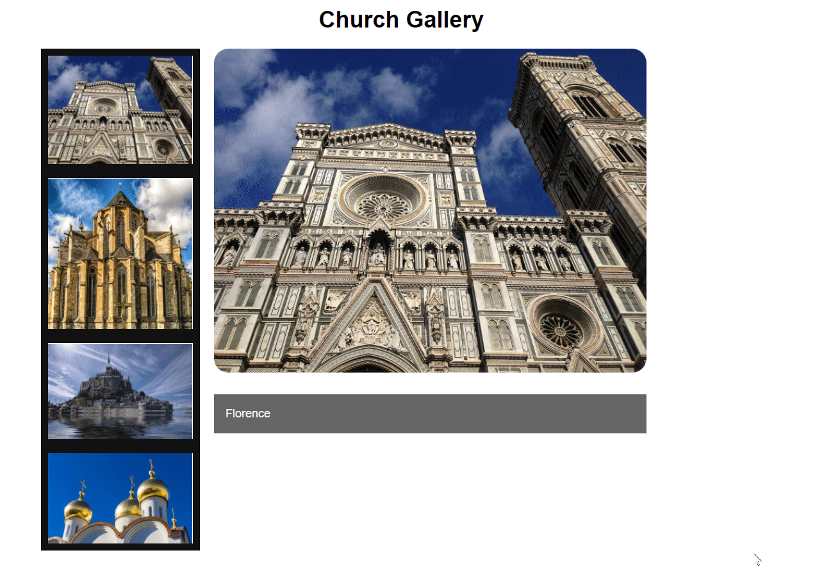
Problem: Church Gallery
You are given:
HTML file + CSS styles
Write the missing CSS and CSS transitions

Slide 17
Solution: Church Gallery CSS
body {
background: #ffffff;
font-family: ‘Avenir’, ‘Arial’;
}
h1 {
text-align: center;
color:#000;
}
#church-container {
background: #ffffff;
overflow: hidden;
position: relative;
width: 80%;
margin: 0 auto;
max-width: 1000px;
}
#church-container input[type="radio"] {
display: none;
}
#church-container label img {
width: 20%;
display: block;
float: left;
clear: left;
border-right: 10px solid #111;
}
#church-container label:hover {
cursor: pointer;
}

Slide 18
Solution: Church Gallery CSS
#churches {
width: 90%;
position: relative;
margin-left: 240px; }
#churches figure {
margin: 0;
position: absolute;
opacity: 0;
transform: scale(0.8);
transition: 0.5s all linear; }
#churches figure img {
width: 450px;
border-radius:20px; }
#churches figure figcaption {
position: relative;
background: rgba(0,0,0,.6);
color: #fff;
font-size: 1rem;
padding: 1rem;
margin-top: 1.6rem;
line-height: 1.4;
text-align: left;
}

Slide 19
Solution: Church Gallery CSS
#florence:checked~#churches #florence-fig,
#altenberger:checked~#churches #altenberger-fig,
#saint-michel:checked~#churches #saint-michel-fig,
#moscow:checked~#churches #moscow-fig
{
opacity: 1;
transform: scale(1);
}
http://stackoverflow.com/questions/10782054/what-does-the-tilde-squiggle-twiddle-css-selector-mean

Slide 20


CSS Animations

Slide 21
CSS Animations Syntax
.example {
animation-name: example;
animation-duration: 1.5s; /* or: Xms */
animation-timing-function:ease-out; /*or:ease, ease-in, ease-in-out,linear*/
animation-delay: 0s; /* or: Xms */
animation-direction: alternate; /* or: normal */
animation-iteration-count: infinite;
animation-fill-mode: none; /* or: backwards, both, forwards */
animation-play-state: running;} /* paused, running, running */
Shorthand syntax:
animation: example 1s 2s 3 alternate backwards

Slide 22

CSS Animations Syntax
@keyframes example {
0% {
transform: scale(.3);
background-color: red;
border-radius: 100%; }
50% {
background-color: orange; }
100% {
transform: scale(1.5);
background-color: yellow; }
}

Slide 23
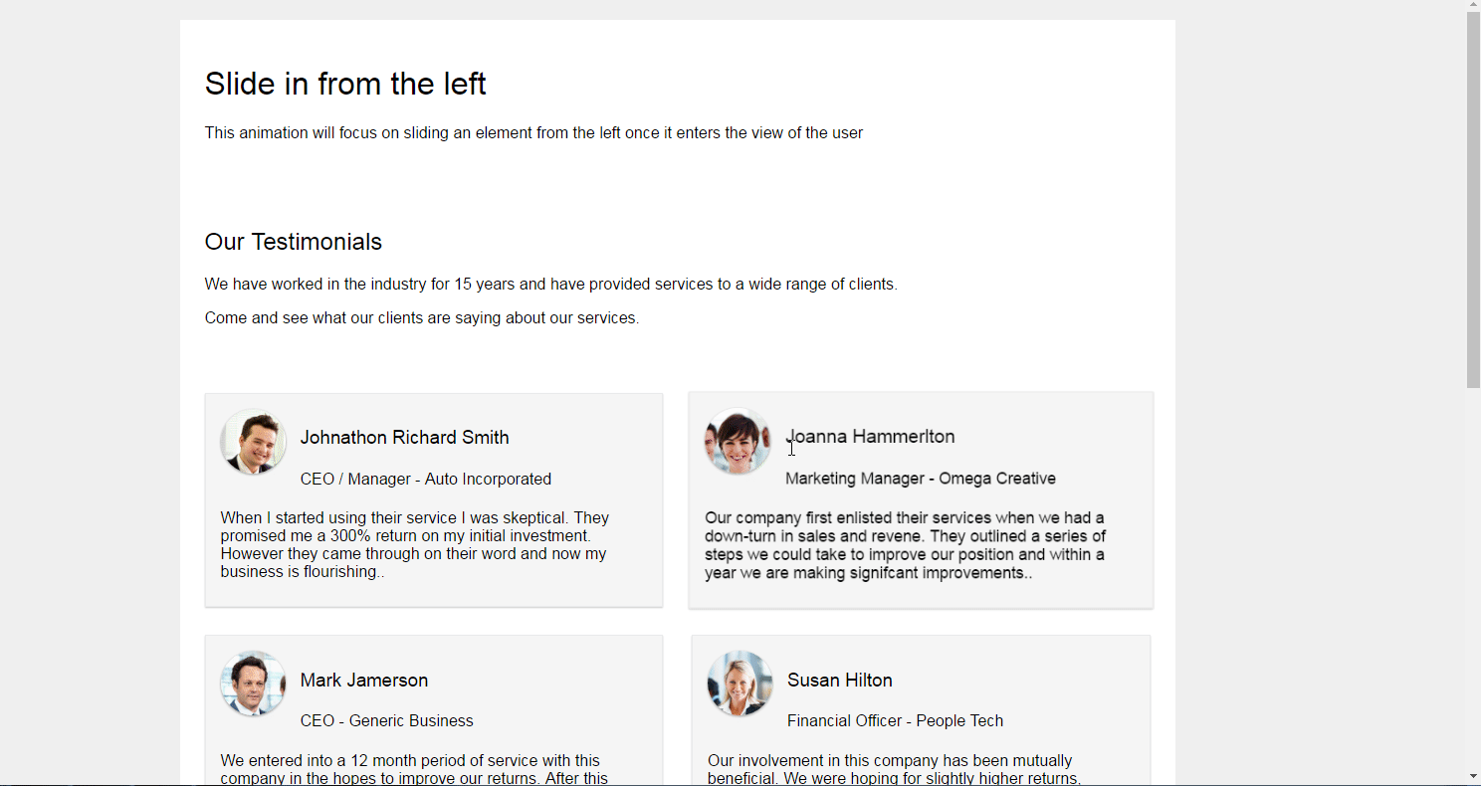
Problem: Scroll Animation
You are given the HTML file
Write the missing CSS file

Slide 24
Solution: Scroll Animation CSS
* {
box-sizing: border-box;
}
.cf:before, .cf:after {
content: " ";
display: block;
}
.cf:after {
clear: both;
}
.main-container {
background: #fff;
max-width: 1000px;
margin:25px auto 25px auto;
position: relative;
}
body {
font-size: 16px;
font-family:'Open Sans',sans-serif;
font-weight: 400;
background: #efefef;
}
strong, b {
font-weight: 600;
}
h1, h2, h3, h4, h5, h6 {
font-weight:300;
}
i.fa {
color:#333;
}

Slide 25
Solution: Scroll Animation CSS
.container {
position: relative;
padding: 25px;
}
.animation-element {
opacity: 0;
}
.animation-element.slide-left {
opacity: 0;
transition: all 900ms linear;
transform: translate(-100px,0px);
}
.animation-element.slide-left.in-view {
opacity: 1;
transform: translate(0px, 0px);
}
.animation-element.slide-left.testimonial:hover {
position: relative;
transform: scale(1.1,1.1);
z-index: 5;
}

Slide 26
Solution: Scroll Animation CSS
.animation-element.slide-left.testimonial {
float: left;
width: 47%;
margin: 0 1.5% 3% 1.5%;
background: #F5F5F5;
padding: 15px;
box-shadow: 0 1px 1px 0 rgba(0,0,0,0.2);
border: solid 1px #EAEAEA;
}
.animation-element.slide-left.testimonial:nth-of-type(odd) {
width: 48.5%;
margin: 0 1.5% 3.0% 0;
}
.animation-element.slide-left.testimonial:nth-of-type(even) {
width: 48.5%;
margin: 0 0 3.0% 1.5%;
}

Slide 27
Solution: Scroll Animation CSS
.animation-element.slide-left.testimonial .header {
width: 100%;
margin-bottom: 10px; }
.animation-element.slide-left.testimonial .left {
float: left;
margin-right: 15px;
}
.animation-element.slide-left.testimonial .right {
float: left;
}
.animation-element.slide-left.testimonial img {
width: 65px;
height: 65px;
border-radius: 50%;
box-shadow: 0 1px 3px rgba(51, 51,51,0.5); }
.animation-element.slide-left.testimonial .content {
float: left;
width: 100%;
margin-bottom: 10px;
}

Slide 28
CSS Grids
Diving into the Depths of CSS Grids

Slide 29

What is CSS Grid & Grid Layout?
CSS Grid – a system for structuring layouts using CSS
CSS Grid Layout
A 2-dimensional grid-based layout system
Divides a page into major regions
Size, position and layers between the
different parts can be easily customized
https://css-tricks.com/snippets/css/complete-guide-grid/

Slide 30
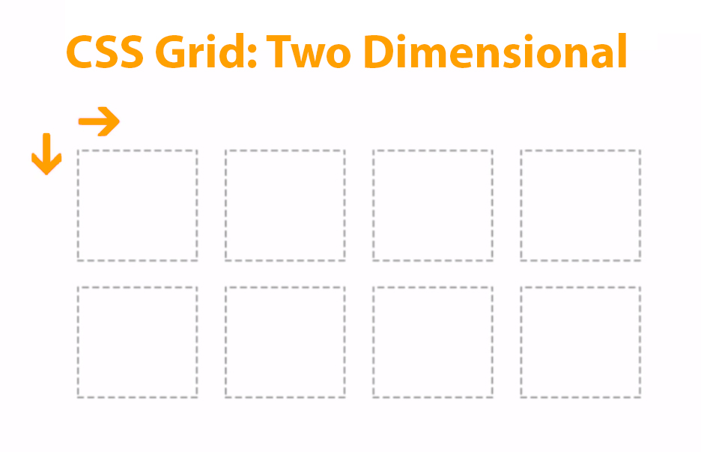
CSS Grid Syntax
CSS Grid is defined using the grid value of the display
Grid syntax:
block-level grid
.grid-container {
display: grid | inline-grid;
}
inline-level grid

Slide 31







CSS Grid – Browser Compatibility
The CSS Grid is 76% supported
Internet Exploler 11+
Edge 16+
Firefox 52.0+
Chrome 57.0+
Safari 10.1+
Opera 44+
Chrome for Android 66+

Slide 32
Grid Columns & Rows
Column and Row properties
Repeating Columns or Rows
Pixels (px)
Percentage (%)
Fractions (fr)
.grid-container {
grid-template-columns: 30px 50% auto;
grid-template-rows: 1fr 1.5fr;
}
Different units for defining
.grid-container {
grid-template-columns: repeat(3,20%) auto;
}

Slide 33
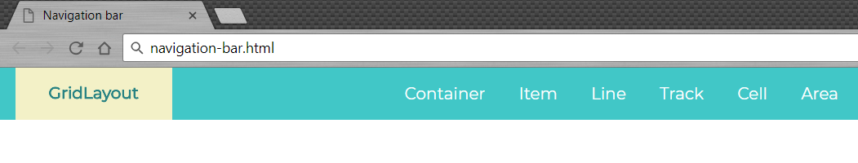
Problem: Navigation Bar
Create a Web page like the screenshot
Constraints:
Use header with display: grid; property and value
Use grid-template-columns
Check your solution here: https://judge.softuni.bg/Contests/608

Slide 34
Solution: Navigation Bar
<html>
<head> … </head>
<body>
<header>
<a href="#" id="logo">GridLayout</a>
<nav>
<ul>
<li><a href="#">Container</a></li>
<!-- TODO: put the next list items here -->
</ul>
</nav>
</header>
</body>
</html>

Slide 35
Solution: Navigation Bar
@import url('https://fonts.googleapis.com/css?family=Montserrat');
body {
margin: 0;
font-family: 'Montserrat', sans-serif;
}
ul {
list-style-type: none;
float: right; }
ul li {
display: inline;
}

Slide 36
Solution: Navigation Bar
ul li a {
color: #fff;
padding: 15px;
}
a {
text-decoration: none;
}
#logo {
padding: 15px;
margin-left: 15px;
background: #f3f1c7;
color: #298383;
text-align: center;
font-weight: bold;
display: inline-block;
}
header {
background: #41c7c7;
display: grid;
grid-template-columns: 20% auto;
}

Slide 37
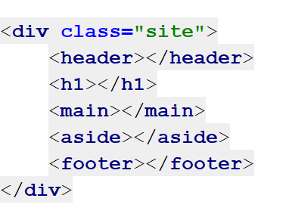
Grid Container
Element containing a grid, defined by setting
Set the display property to grid or inline-grid
Containers consist of grid items,
placed inside columns and rows.
.site {
display: grid | inline-grid;
}

Slide 38
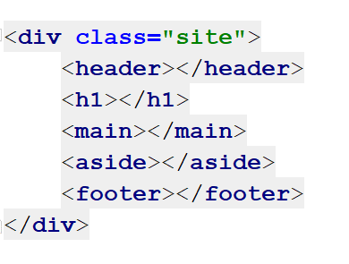
Grid Item
A grid container contains grid items
A container has one grid item for each column, in each row
Child Elements ( Items ) is a direct descendant of the grid container

Slide 39
Grid Line
Horizontal (row) or vertical (column) line separating the grid into sections.
Items can be placed onto the grid with line number
The lines can be named, by adding the name in square brackets

Slide 40
Grid Cell
The intersection between a grid row and a grid column
Effectively the same as a table cell
More than one item can be placed into a grid cell

Slide 41
Grid Area
Grid areas can cover one or more cells
Specifies a grid item's size and location in a grid layout
Have the following properties:
grid-row-start
grid-column-start
grid-row-end
grid-column-end

Slide 42
Grid Тrack
The space between two or more grid lines
Row tracks are horizontal
Columns tracks are vertical
Have the following properties:
grid-template
grid-template-columns
grid-template-rows

Slide 43
Grid Gap
The space between grid tracks
CSS Grid Layout initially defined the grid-gap property
Have the following properties:
gap
row-gap
column-gap

Slide 44
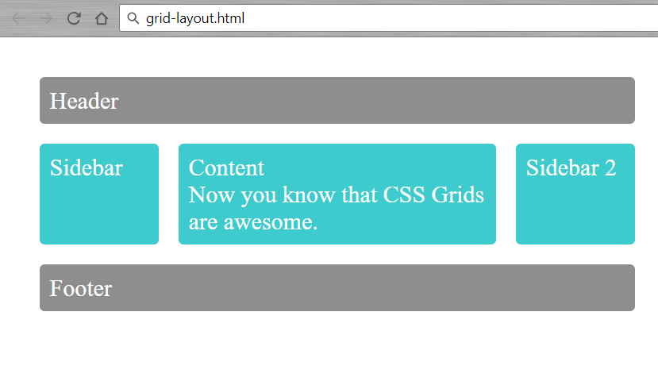
Problem: Simple Grid Layout
Create a Web page like the screenshot
You are NOT allowed to change the HTML
Constraints:
Use grid-template-areas
Check your solution here: https://judge.softuni.bg/Contests/608

Slide 45
Solution: Simple Grid Layout
body {
margin: 40px; }
.sidebar {
grid-area: sidebar; }
.sidebar2 {
grid-area: sidebar2; }
.content {
grid-area: content; }
.header {
grid-area: header; }
.footer {
grid-area: footer; }
.wrapper {
background-color: #fff;
color: #444; }
.wrapper {
display: grid;
grid-gap: 1em;
grid-template-areas:
"header" "sidebar"
"header" "sidebar"
"content" "sidebar2"
"footer"; }

Slide 46
Solution: Simple Grid Layout
@media only screen and (min-width: 500px) {
.wrapper {
grid-template-columns: 20% auto;
grid-template-areas:
"header header"
"sidebar content"
"sidebar2 sidebar2"
"footer footer"; } }
@media only screen and (min-width: 600px) {
<!-- TODO: align grid template areas here -->
}
.box {
background: #3ecbce;
color: #fff;
border-radius: 5px;
padding: 10px;
font-size: 150%;
}
.header, .footer {
background: rgba(140, 140, 140, 0.98);
}
Check your solution here: https://judge.softuni.bg/Contests/608

Slide 47



Summary
CSS Transitions change slowly properties
CSS Animations provide sequence of changes
CSS Grids is the most powerful layout system
available in CSS
div {
transition: all ease 0.5s;
}

Slide 48







Web Fundamentals – Course Introduction
https://softuni.bg/courses/web-fundamentals-html5

Slide 49






SoftUni Diamond Partners

Slide 50






SoftUni Diamond Partners

Slide 51
License
This course (slides, examples, demos, videos, homework, etc.) is licensed under the "Creative Commons Attribution-NonCommercial-ShareAlike 4.0 International" license

Slide 52





Trainings @ Software University (SoftUni)
Software University – High-Quality Education, Profession and Job for Software Developers
softuni.bg
Software University Foundation
http://softuni.foundation/
Software University @ Facebook
facebook.com/SoftwareUniversity
Software University Forums
forum.softuni.bg

